Slide 1
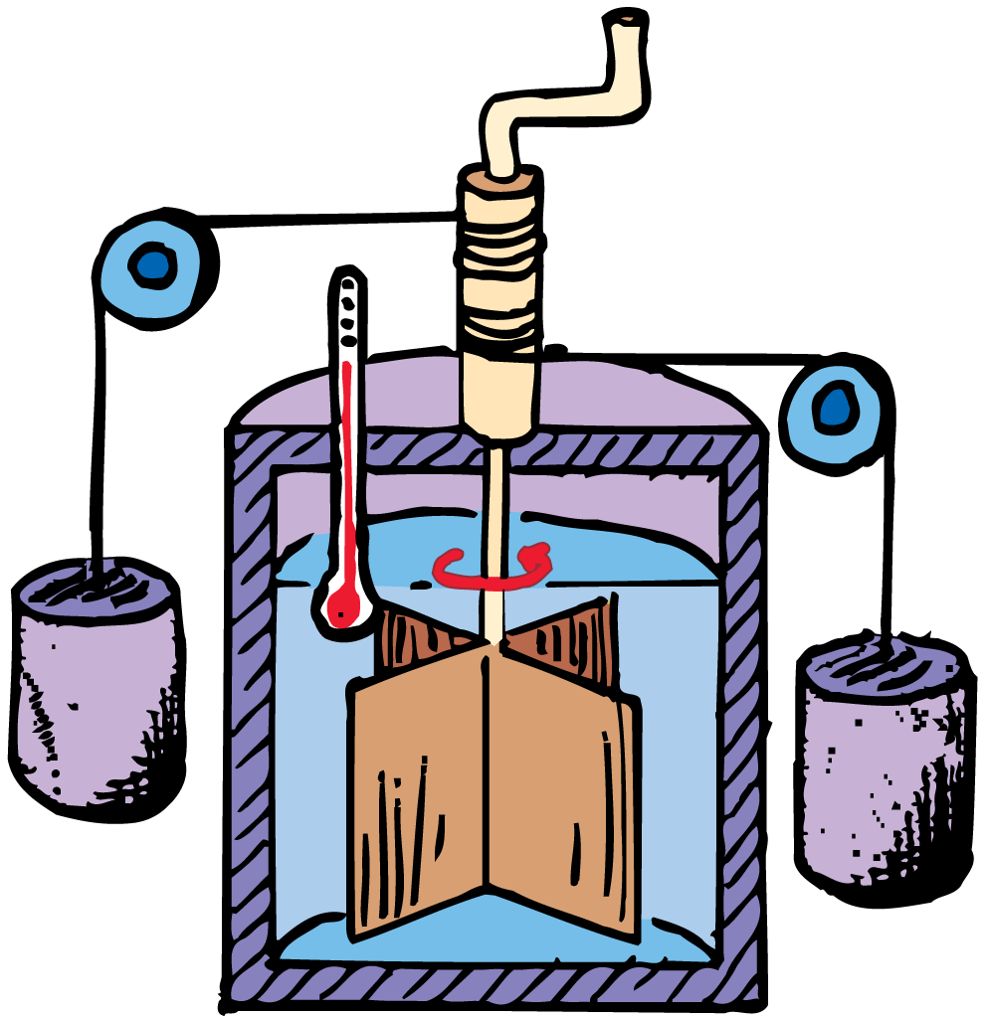

Thermodynamic Notes
Heat flows from hot to cold.

Slide 2
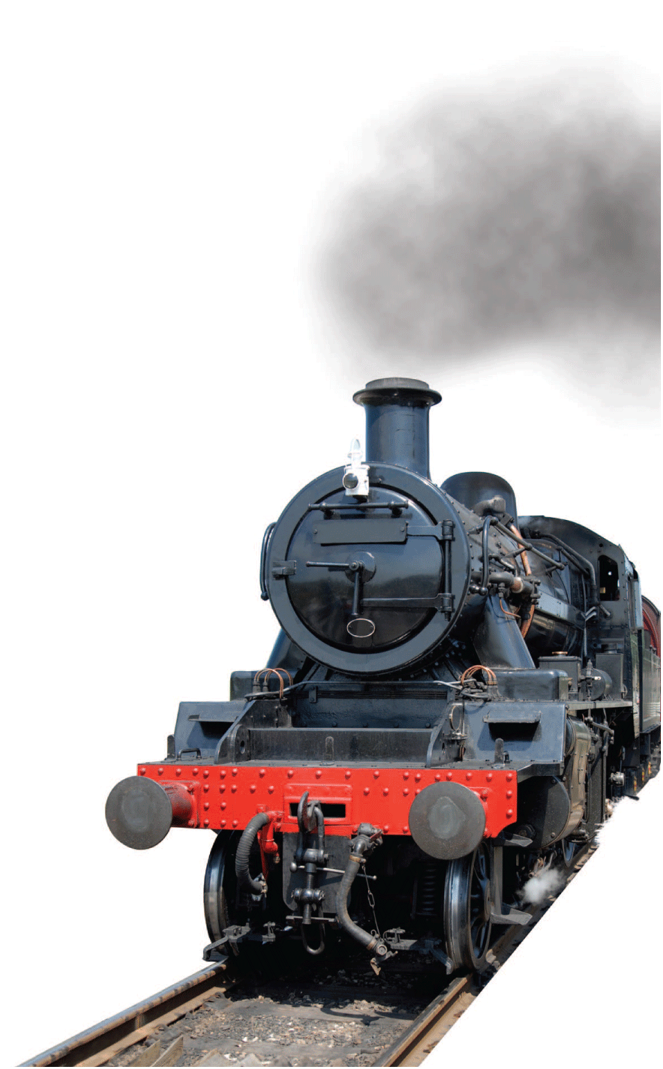
Thermodynamics
The study of heat and its transformation into mechanical energy is called thermodynamics.
The foundation of thermodynamics is the conservation of energy and the fact that heat flows from hot to cold. It provides the basic theory of heat engines.

Slide 3
First Law of Thermodynamics
The first law of thermodynamics states that whenever heat is added to a system, it transforms to an equal amount of some other form of energy.

Slide 4
First Law of Thermodynamics - Heat
By system, we mean any group of atoms, molecules, particles, or objects we wish to deal with.
  The system may be the steam in a steam engine,
  the whole Earth’s atmosphere,
  or even the body of a living creature.
It is important to define what is contained within the system as well as what is outside of it.

Slide 5
First Law of Thermodynamics - Heat
If we add heat energy to a system, the added energy does one or both of two things:
  increases the internal energy of the system if it remains in the system
  does external work if it leaves the system
So, the first law of thermodynamics states:
Heat added =
increase in internal energy + external work done by the system

Slide 6
First Law of Thermodynamics - Work
Adding heat is not the only way to increase the internal energy of a system.
If we set the “heat added” part of the first law to zero, changes in internal energy are equal to the work done on or by the system.
If work is done on a system—compressing it, for example—the internal energy will increase.
The temperature of the system rises without any heat input.
If work is done by the system—expanding against its surroundings, for example—the system’s internal energy will decrease.
With no heat extracted, the system cools.

Slide 7
Adiabatic Processes
When work is done on a gas by adiabatically compressing it, the gas gains internal energy and becomes warmer.
When a gas is compressed or expanded so that no heat enters or leaves a system, the process is said to be adiabatic.
Adiabatic changes of volume can be achieved by performing the process rapidly so that heat has little time to enter or leave or by thermally insulating a system from its surroundings.

Slide 8
Second Law of Thermodynamics
The second law of thermodynamics states that heat will never of itself flow from a cold object to a hot object.
Heat flows one way, from hot to cold.
  In winter, heat flows from inside a warm heated home to the cold air outside.
  In summer, heat flows from the hot air outside into the home’s cooler interior.
  Heat can be made to flow the other way, but only by imposing external effort—as occurs with heat pumps.

Slide 9
Heat and the Second Law
According to the second law of thermodynamics, no heat engine can convert all heat input to mechanical energy output.
It is easy to change work completely into heat—simply rub your hands together briskly.
All the work you do in overcoming friction is completely converted to heat.
However, changing heat completely into work can never occur.
The best that can be done is the conversion of some heat to mechanical work.

Slide 10
Heat Engines and the Second Law
A heat engine is any device that changes internal energy into mechanical work.
The basic idea behind a heat engine is that mechanical work can be obtained as heat flows from high temperature to low temperature.
Some of the heat can be transformed into work in a heat engine.

Slide 11
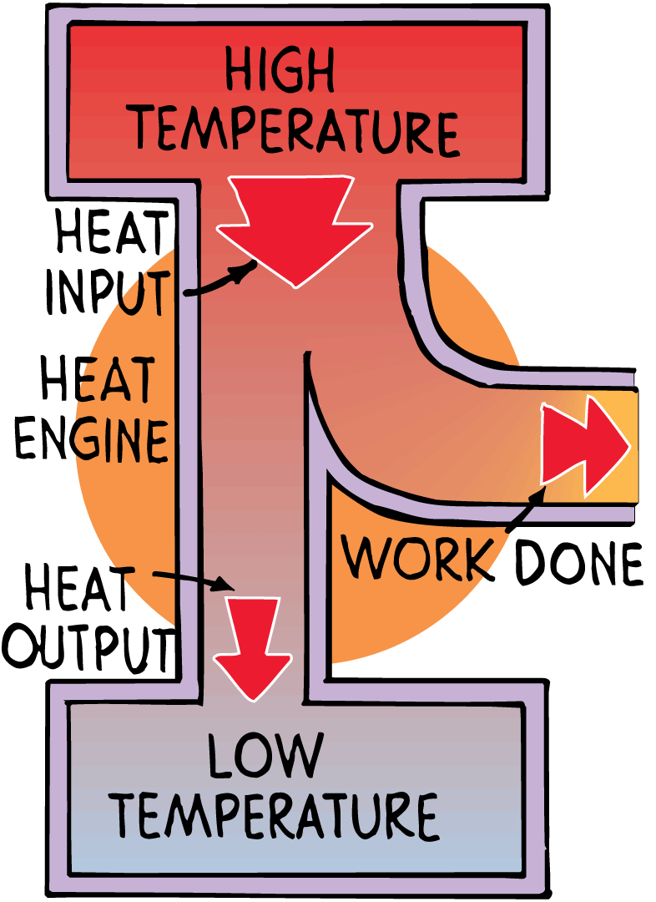
Heat Engines and the Second Law
When heat energy flows in any heat engine from a high-temperature place to a low-temperature place, part of this energy is transformed into work output.

Slide 12
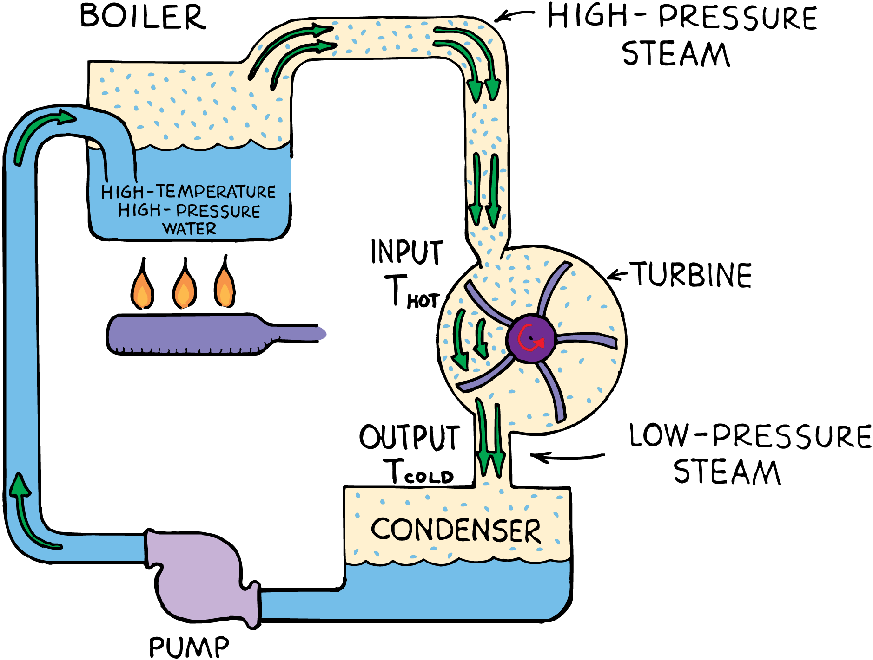
Heat Engines and the Second Law
A steam turbine engine demonstrates the role of temperature difference between heat reservoir and sink.

Slide 13
Heat Engines Efficiency
The second law states that when work is done by a heat engine running between two temperatures, T_{hot} and T_{cold}, only some of the input heat at T_{hot} can be converted to work.
The rest is expelled as heat at T_{cold}.

Slide 14
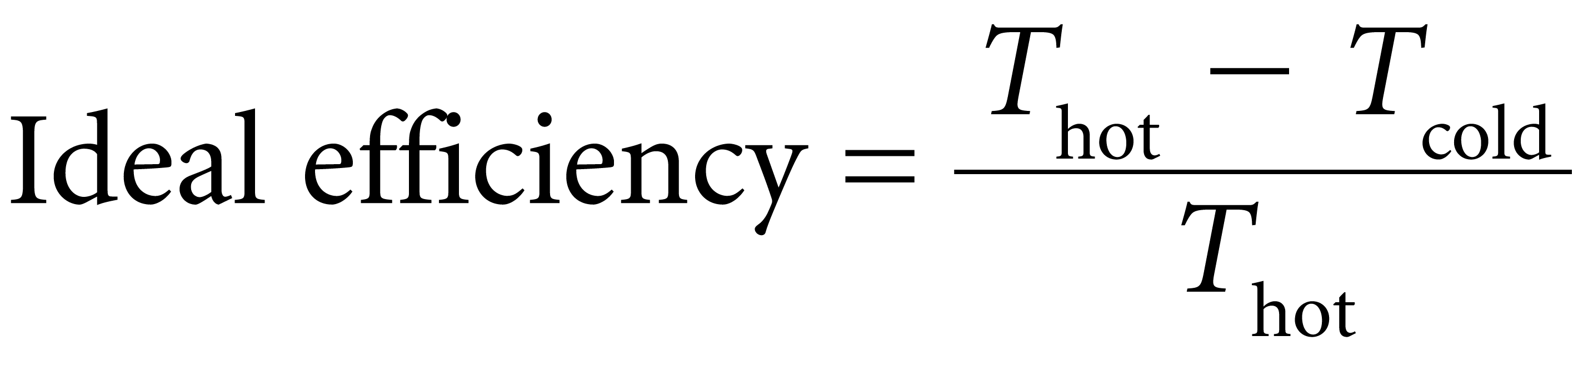
Heat Engines Efficiency
The Carnot efficiency, or ideal efficiency, of a heat engine is the ideal maximum percentage of input energy that the engine can convert to work.
T_{hot} is the temperature of the hot reservoir.
T_{cold} is the temperature of the cold.

Slide 15
Heat Engine Efficiency
Ideal efficiency depends only on the temperature difference between input and exhaust.
When temperature ratios are involved, the absolute temperature scale must be used, so T_{hot} and T_{cold} are expressed in kelvins.
The higher the steam temperature driving a motor or turbogenerator, the higher the efficiency of power production.

Slide 16
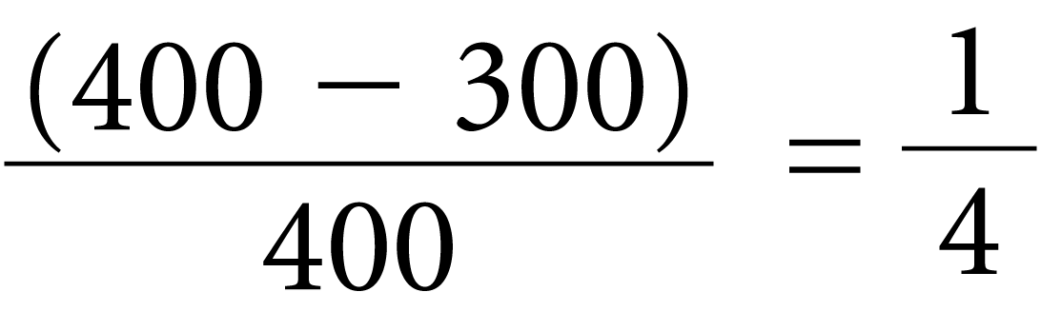
Heat Engines Efficiency Example
For example, when the heat reservoir in a steam turbine is 400 K (127°C) and the sink is 300 K (27°C), the ideal efficiency is
Under ideal conditions, 25% of the internal energy of the steam can become work, while the remaining 75% is expelled as waste.
Increasing operating temperature to 600 K yields an efficiency of (600 — 300)/600 = 1/2, twice the efficiency at 400 K.

Slide 17
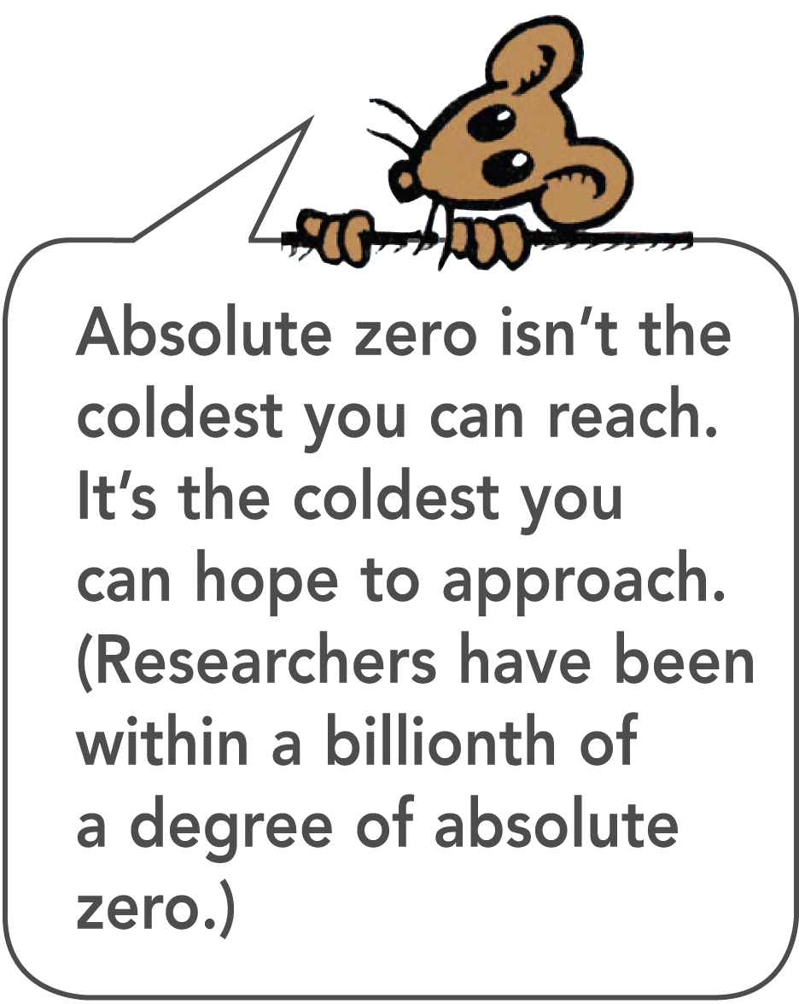
Third Law of Thermodynamics
Third law of thermodynamics: no system can reach absolute zero.
As investigators attempt to reach this lowest temperature, it becomes more difficult to get closer to it.
Physicists have been able to record temperatures that are less than a millionth of 1 kelvin—but never as low as 0 K.

Slide 18

Order Tends to Disorder
Natural systems tend to proceed toward a state of greater disorder.
Imagine that in a corner of a room sits a closed jar filled with argon gas atoms.
When the lid is removed, the argon atoms move in haphazard directions, eventually mixing with the air molecules in the room.

Slide 19
Entropy
According to the second law of thermodynamics, in the long run, the entropy of a system always increases for natural processes.
Entropy is the measure of the amount of disorder in a system.
Disorder increases; entropy increases

Slide 20
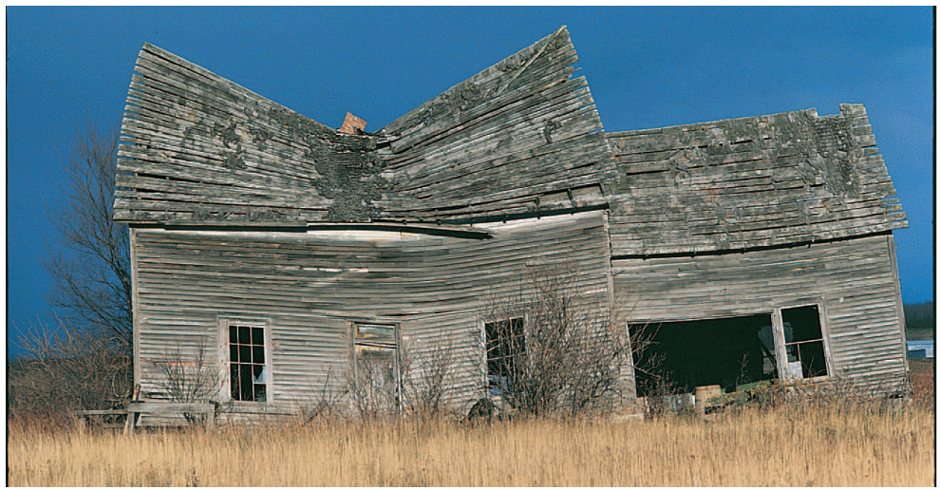
Entropy
This run-down house demonstrates entropy. Without continual maintenance, the house will eventually fall apart.

Slide 21
Entropy
Entropy normally increases in physical systems.
However, when there is work input, as in living organisms, entropy decreases.
All living things extract energy from their surroundings and use it to increase their own organization.
This order is maintained by increasing entropy elsewhere.

